Slide 1
StackHack 1.0
THEME: Task Management To-do list
TITLE : ScheduleIt
By: ANISH SHUKLA
PURBASA KAR

Slide 2
Introduction
We, here are trying to make one in all task management web application. Here, in this project, every user can create their account and then manage tasks and maintain a to-do using a simple yet intuitive User Interface. The user can broadly classify all tasks in 3 broad categories which are Personal, Work, and Others. In, others is a specific section where user can put all the task which are neither closely associated to the work or personal category. Also, a user can update the progress of the task. Updating is broadly classified into 4 categories which are 'IN PROGRESS', 'COMPLETED', 'NOT STARTED' and the user can also 'CANCEL' a task. Also, all the ongoing, future and completed tasks can be seen on the Dashboard where completed tasks, cancelled tasks and the tasks for which deadline has passed will go in the Archived section where completed tasks will be marked as Complete and the later one as incomplete whereas rest which are still ongoing and are not cancelled are in Active section.

Slide 3
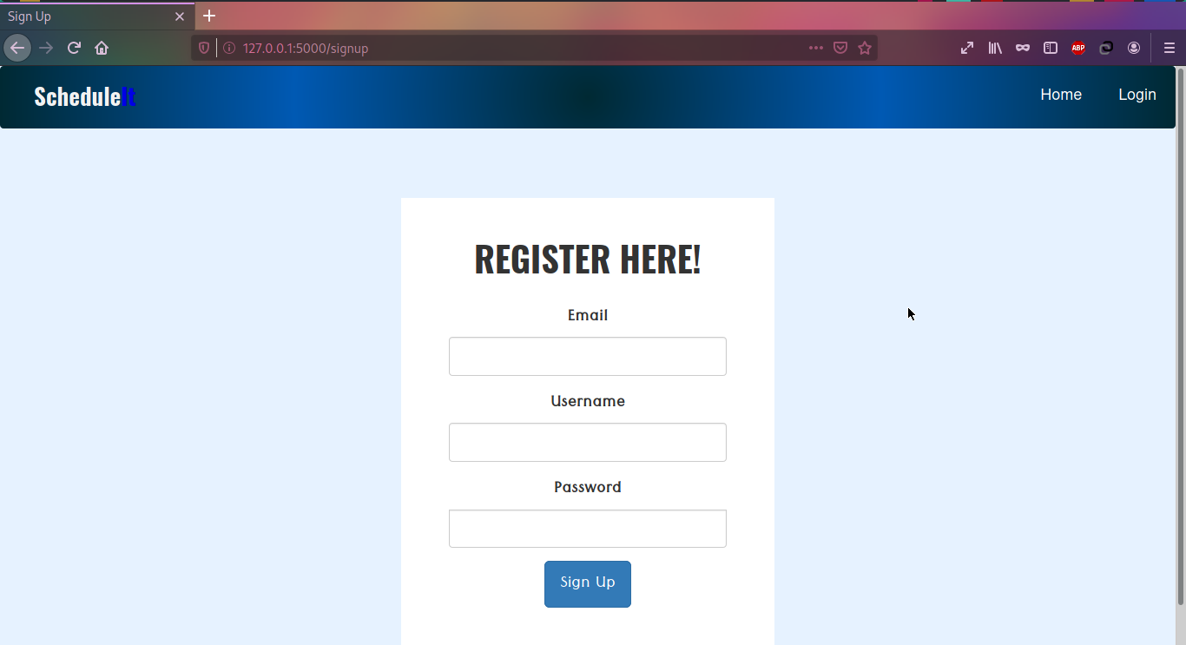
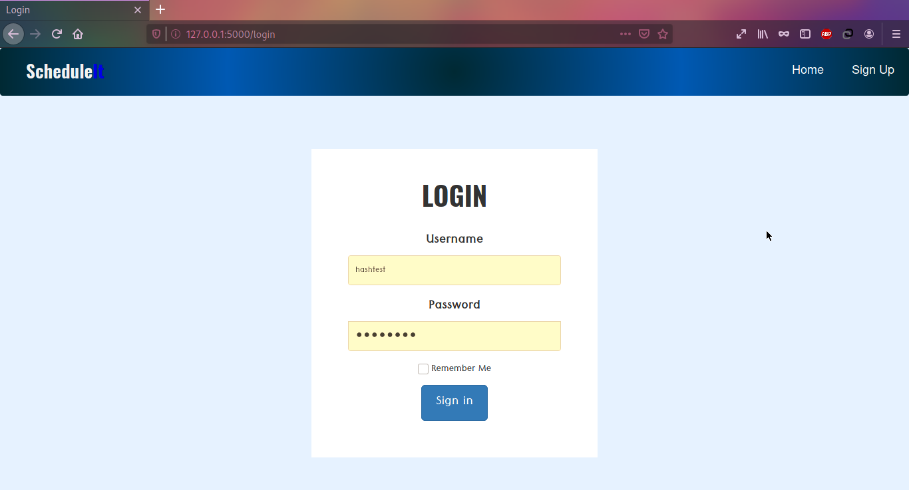
Registration Page
Login Page

Slide 4
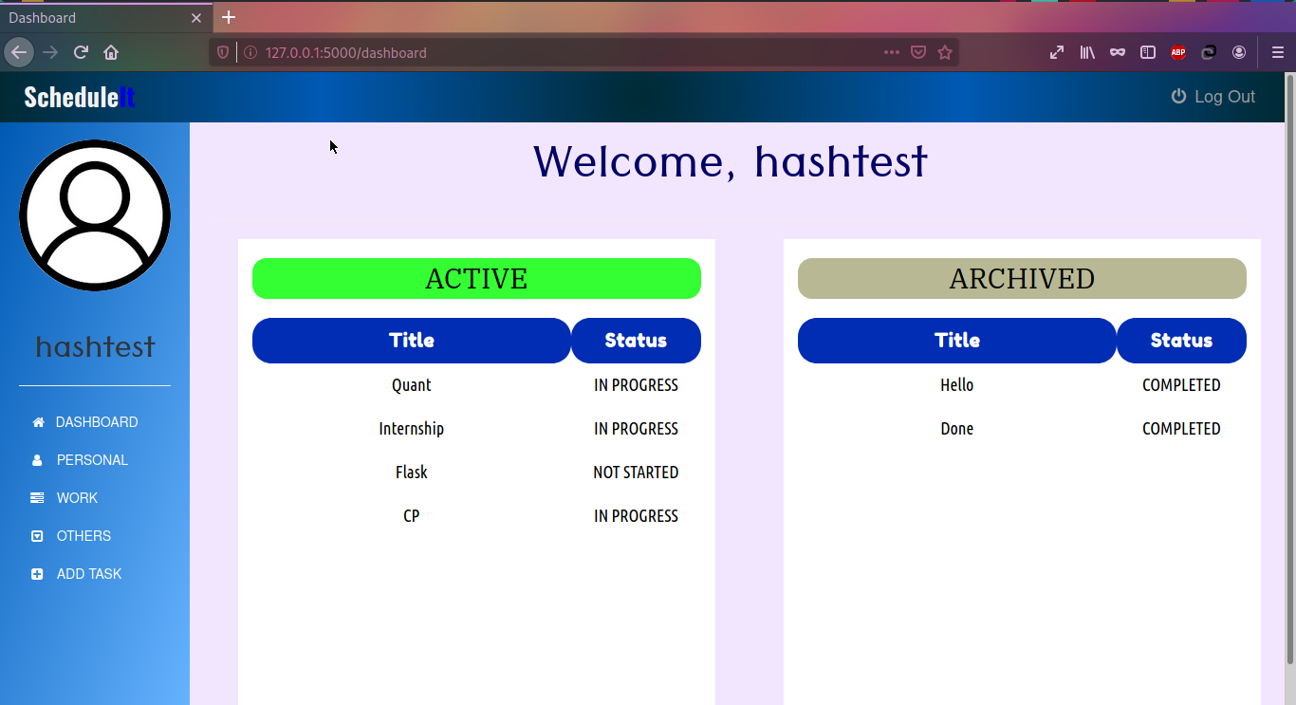
DashBoard
On the left is the navigator sidebar and on the top is navigator topbar. The Dashboard is in two section where ACTIVE contains all the pending tasks of the user whereas ARCHIVED contains all the previous and presently not worked upon tasks of the user.

Slide 5
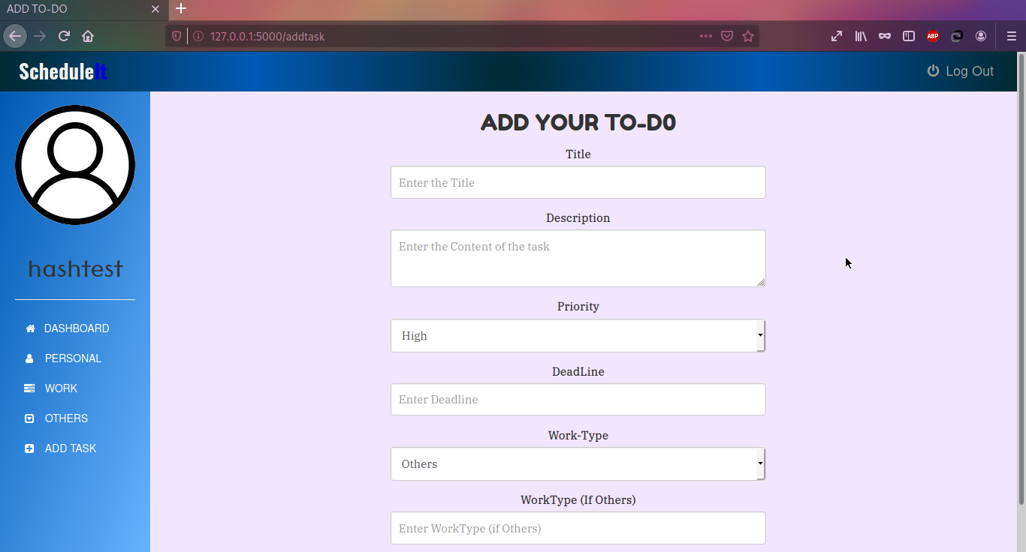
ADD TO-DO
This is the page where user can add the task with a small note in the description can give title to the task can assign priority to the task, can give deadline for the task. The Work Type and Priority are a select type task where the selected field in Work Type defines whether the task will be added to personal, work or the other section visible on navigation sidebar. On the following next three slides we will be seeing each of the three section.

Slide 6
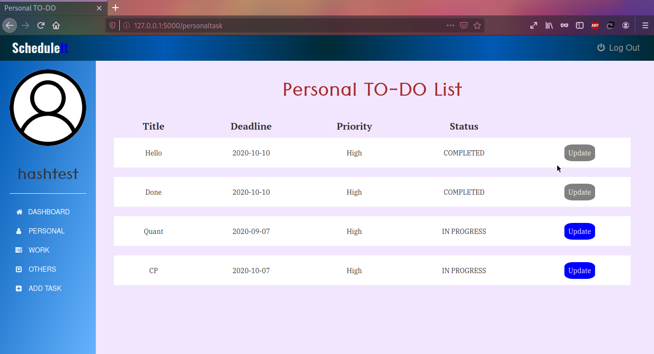
Personal TO-DO List

Slide 7
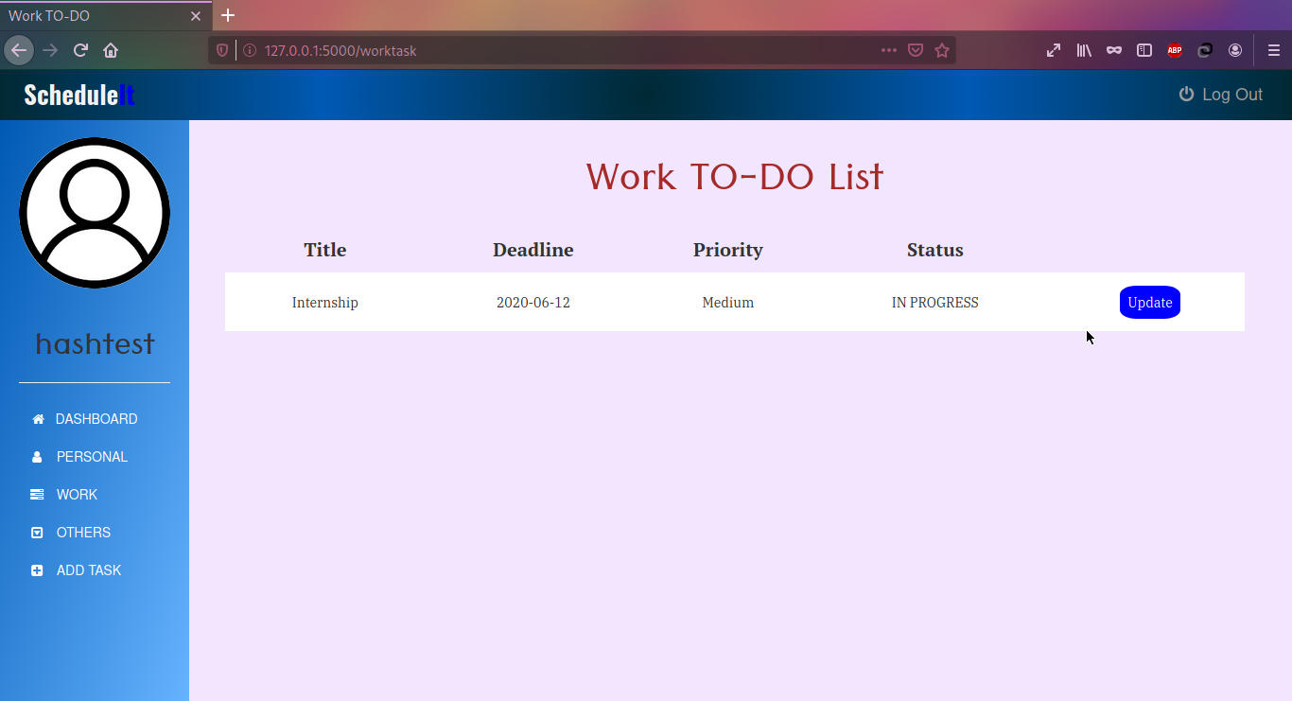
Work TO-DO List

Slide 8
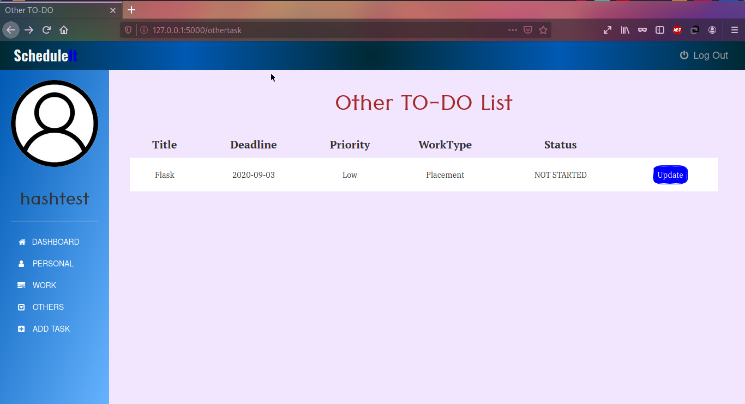
Other TO-DO List

Slide 9
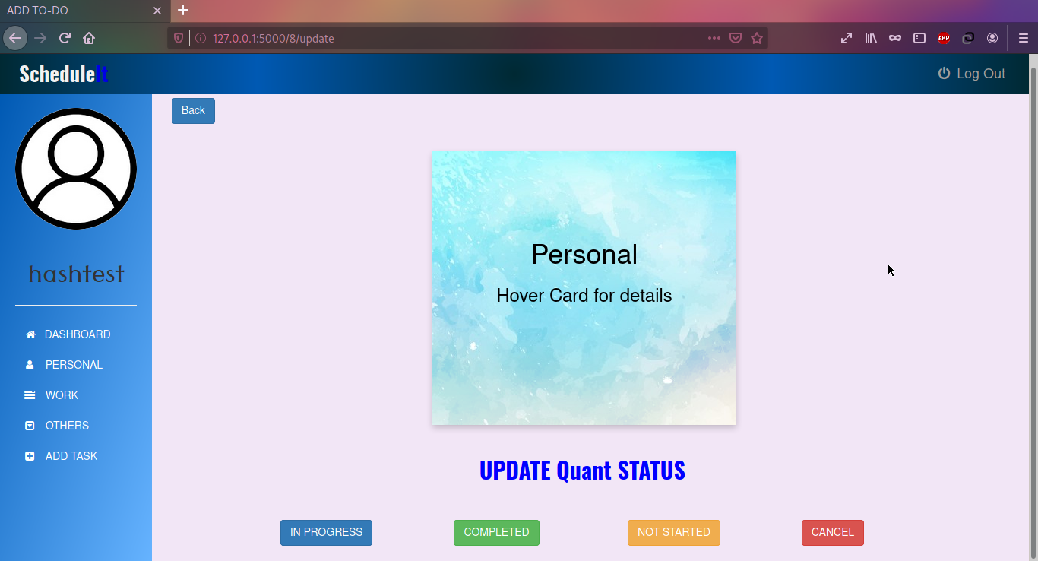
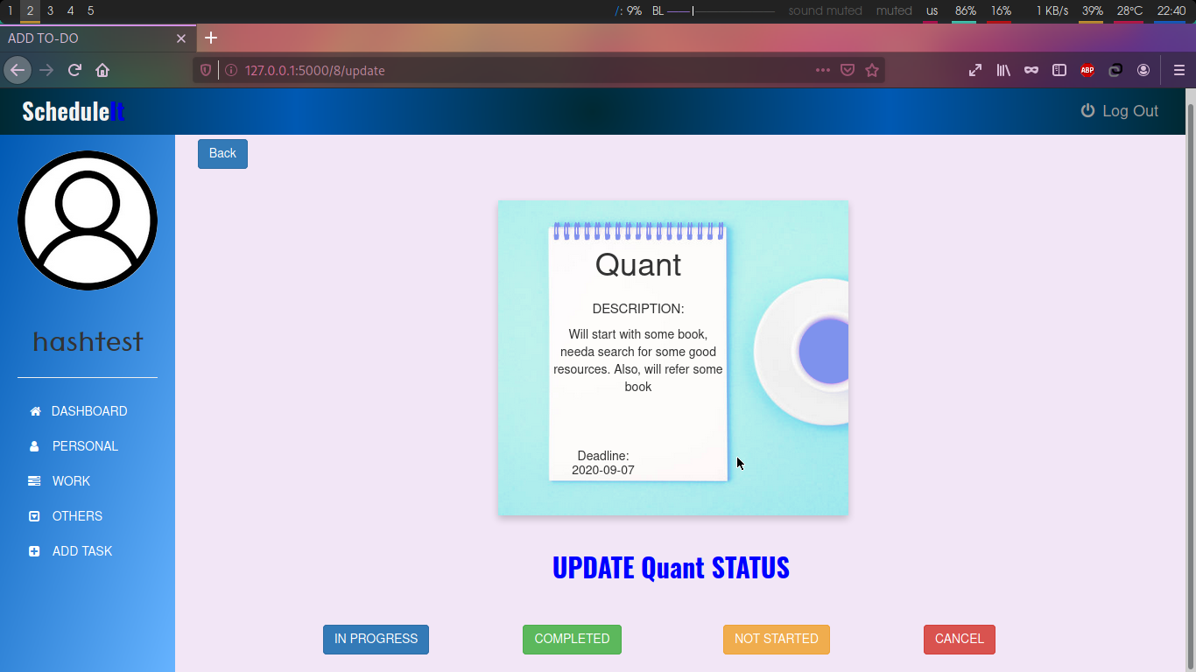
Updating Status of TO-DO
This is where the update button on the last three pages land to. User can read the details of the tasks and can go through description where user can write notes also user can update the current status of the task by clicking one of the buttons below. The center of the update page is a flipping-card. The next time when user checks the status the user sees the last updated status.

Slide 10
FUTURE WORK
Search and Filter option can be added.
Delete Task for each individual task can be added.
Delete Archive Tasks can be added.
Delete Active Tasks can be added.
Edit option for each individual task can be added.
Profile Picture update can be made available.
Make a Reminder system which reminds the user to add their daily progress
Fetch daily progress api and make a timeline

